Slide 1



CAPSTONE PRESENTATION
ARTIFICIAL INTELLIGENCE BOOTCAMP 2025
Emotional Speech Detector
Reem Basho
Yasmine Hariri
Rand Al Yaman
Mahdi Dagher
Saida, 3 October 2025

Slide 2
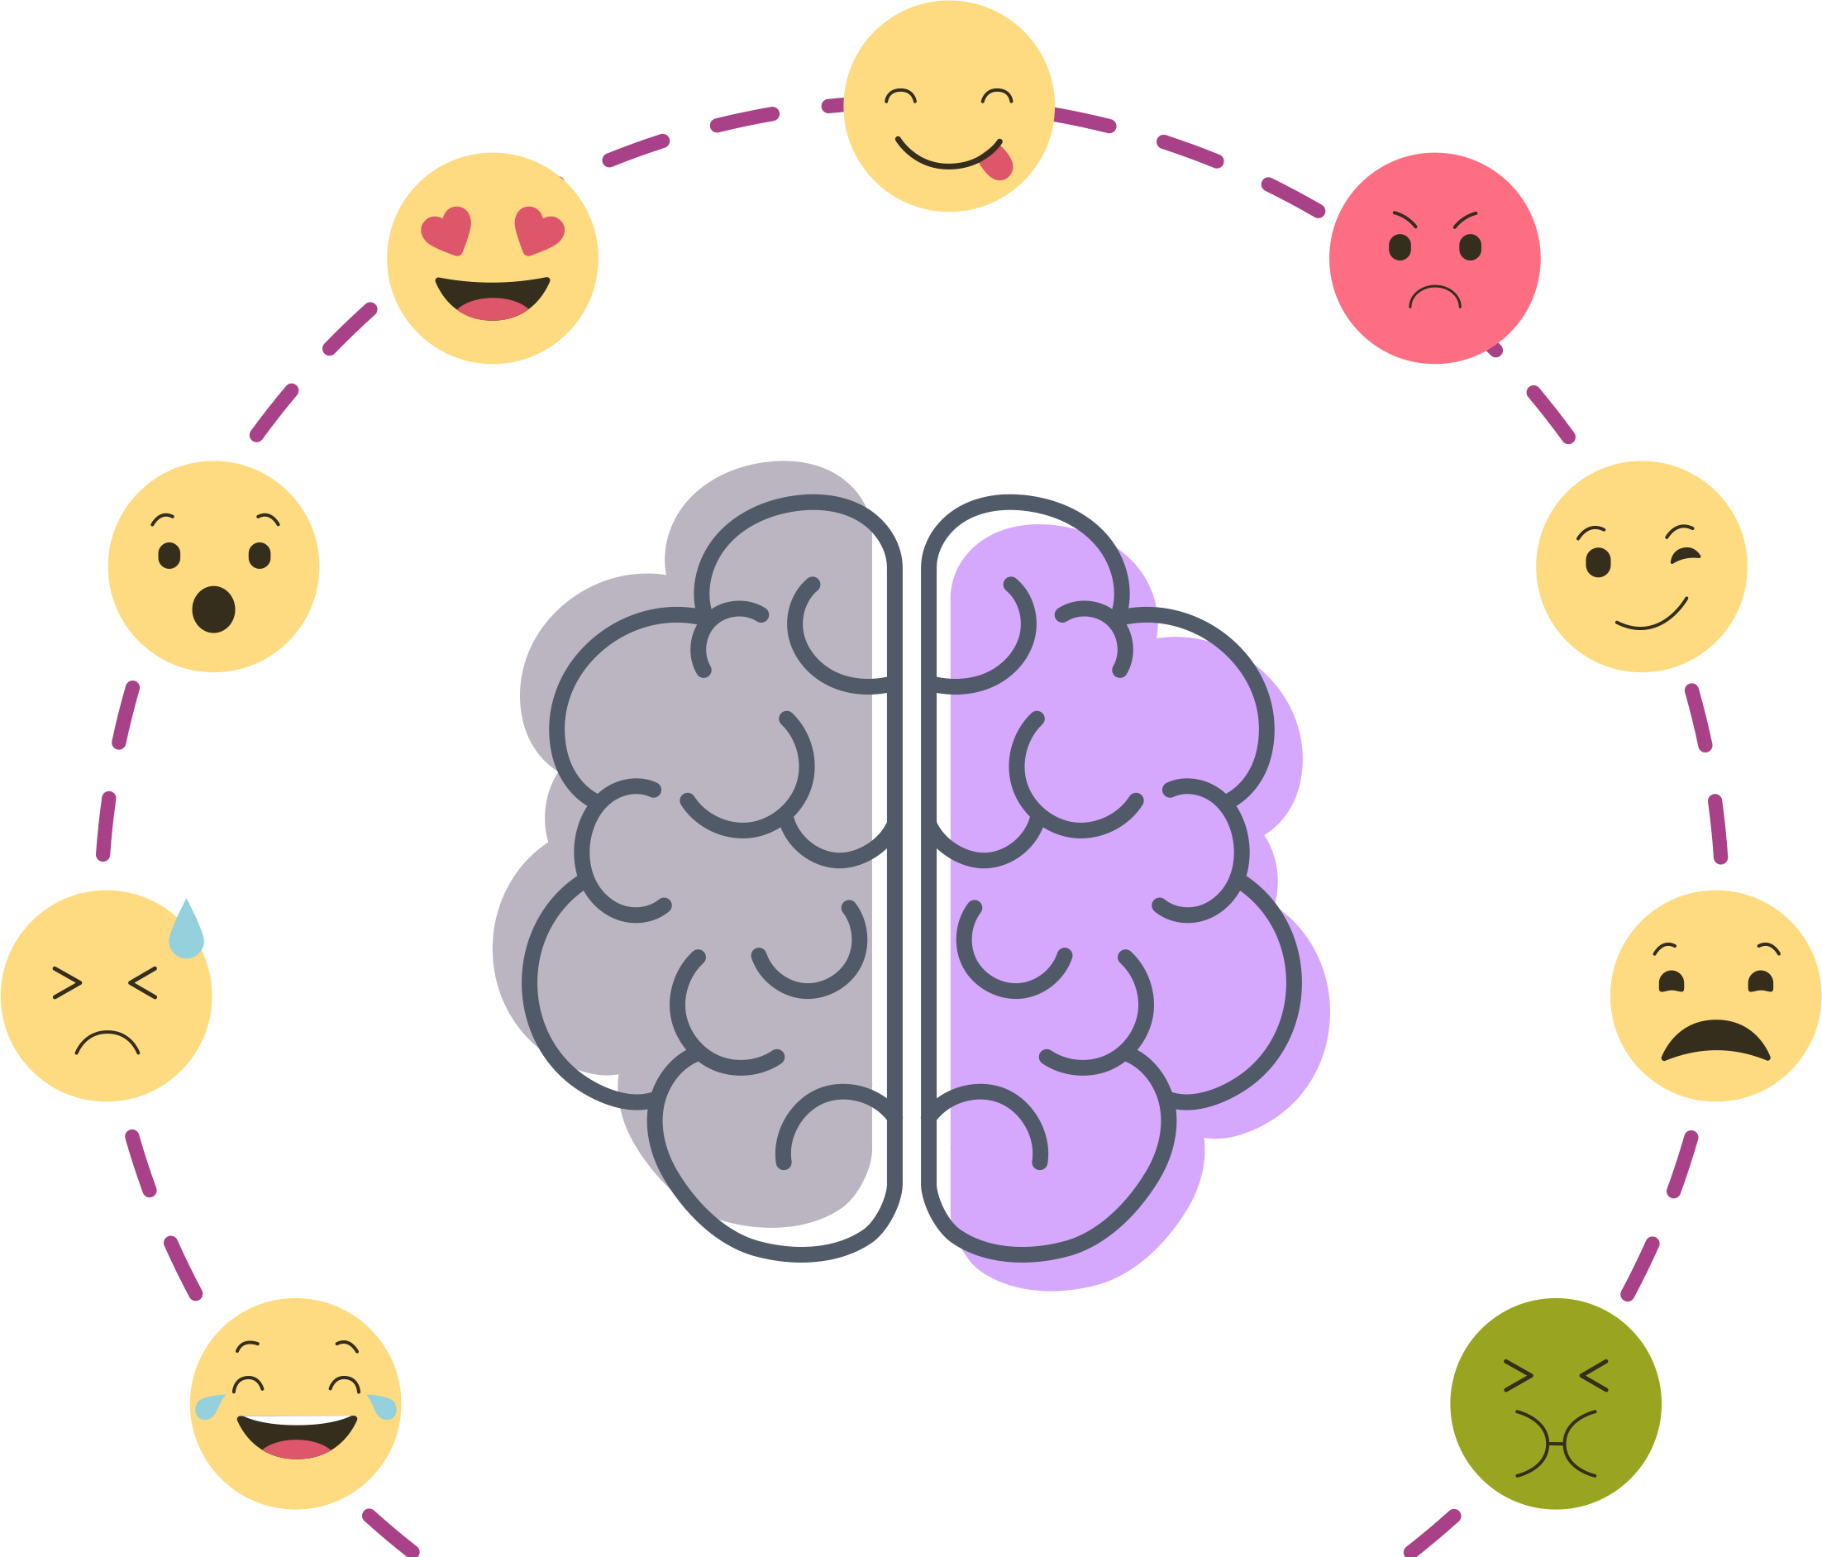
Project Overview
Goal: Detect emotions from speech.
How: Used speech features (MFCC) with machine learning and deep learning models.
Why: Useful for virtual assistants, call centers, and mental health support.
Challenge: Emotions are difficult for computers to understand and classify.
Importance: Helps improve human-computer interaction and real-life applications.
Emotional Speech Detector

Slide 3
Outline
Introduction
Methodology
Implementation and Results
Model Demonstration and Future Vision
Emotional Speech Detector

Slide 4
1. Introduction
1.1 Importance of Emotional Speech Detection
1.2 Problems and Challenges
1.3 Objectives of the project
1.4 Literature Gap and Novelty
1.5 Contributions of this project
Emotional Speech Detector

Slide 5
2. Methodology:
Material, Software, and Equipment used
Preprocessing Pipeline
Datasets
Emotional Speech Detector

Slide 6











2.1 Material, Software, and Equipment used
Emotional Speech Detector

Slide 7
2.2 Preprocessing Pipeline
Standardized to 16 kHz
Removed silence (leading/trailing)
Wiener filtering for noise reduction
HP/LP filtering + peak normalization
Segmented into 3s windows (50% overlap)
Kept utterance segments together (no leakage)
Emotional Speech Detector

Slide 8
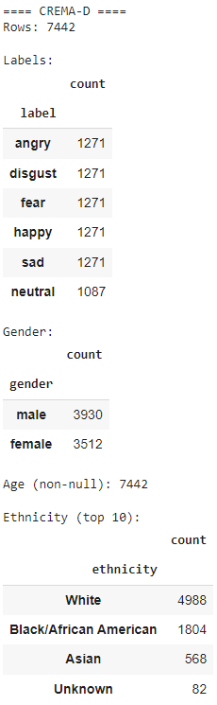
2.3 Datasets: CREMA-D, RAVDESS, and EmoDB
CREMA-D
The CREMA-D dataset is a large, publicly available collection of audio-visual clips from 91 actors, designed for training and evaluating speech emotion recognition (SER) models
Emotional Speech Detector

Slide 9
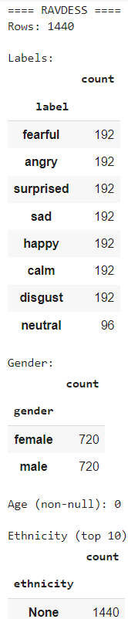
2.3 Datasets: CREMA-D, RAVDESS, and EmoDB
RAVDESS
The RAVDESS (Ryerson Audio-Visual Database of Emotional Speech and Song) dataset is a validated multimodal database of emotional speech and song recordings by 24 professional actors (12 male, 12 female).
Emotional Speech Detector

Slide 10
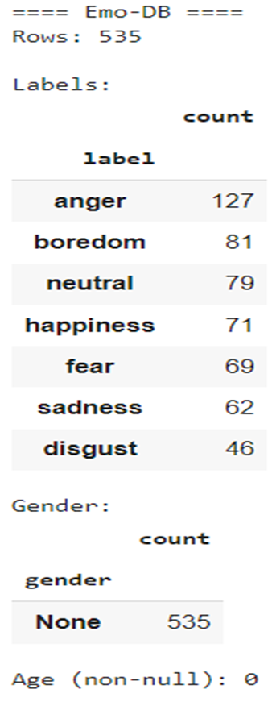
2.3 Datasets: CREMA-D, RAVDESS, and EmoDB
EmoDB
The EMODB (German Emotional Speech Database) is a widely used German-language dataset of acted emotional speech, created by TU Berlin for analyzing how emotions are expressed in voice
Emotional Speech Detector

Slide 11
Data Cleaning
Resampling: All audio resampled to 16 kHz.
Silence Trimming: Removed leading/trailing silence (40 dB threshold).
Noise Reduction: Reduced background noise while keeping speech clear.
Deterministic Cleaning: Standardized length, filtered (60–7800 Hz), removed silence, and normalized amplitude.
Audio Segmentation: Split into overlapping 3-second windows (50% overlap).
Emotional Speech Detector

Slide 12
Data Cleaning: Techniques and Approaches
Feature Extraction: Extracted MFCCs, pitch, and mean MFCCs for modeling emotions.
Modeling Approach: SVM (best), Random Forest (simple), CNN (patterns only), LSTM (needs more data), LSTM+CNN (too complex).
Emotional Speech Detector

Slide 13
Data Cleaning: Training and Evaluation
Training
Input: Audio → Preprocessing (noise removal, normalization)
Feature extraction: MFCCs, Spectrograms
Models trained: SVM, CNN, LSTM
Data split: 80% training / 20% testing
Evaluation
Metrics: Accuracy, Precision, Recall, Confusion Matrix
Compared model performances
Best performer: SVM (most consistent accuracy with our dataset size)
Emotional Speech Detector

Slide 14
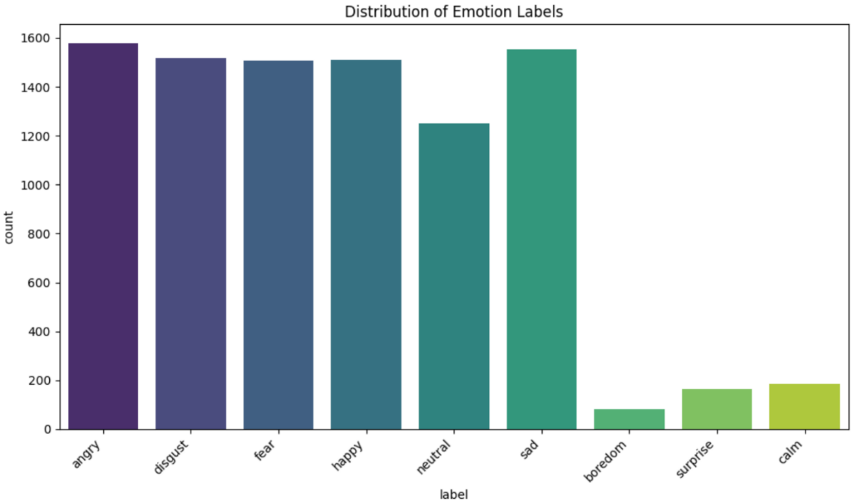
Data Cleaning: Exploratory Data Analysis (EDA)
Imbalanced Emotion Distribution
Emotional Speech Detector

Slide 15
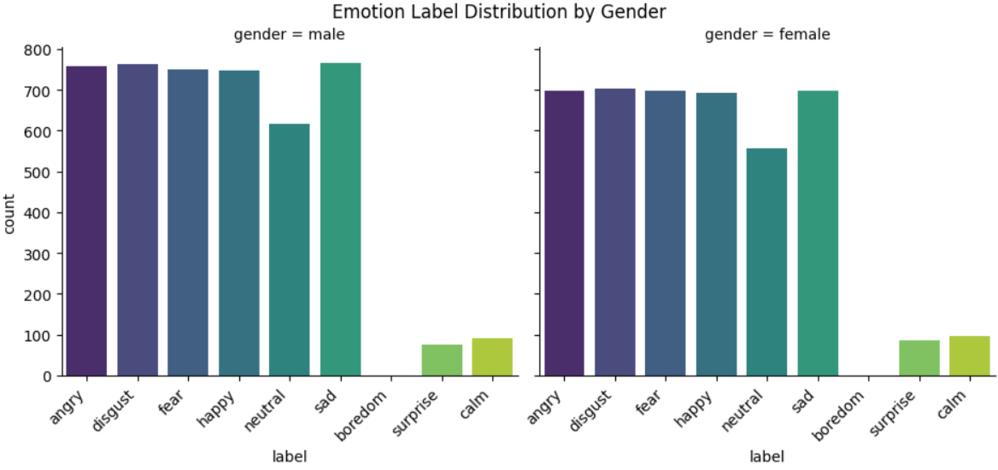
Data Cleaning: Exploratory Data Analysis (EDA)
2. Gender 55% male, 45% female
Emotional Speech Detector

Slide 16
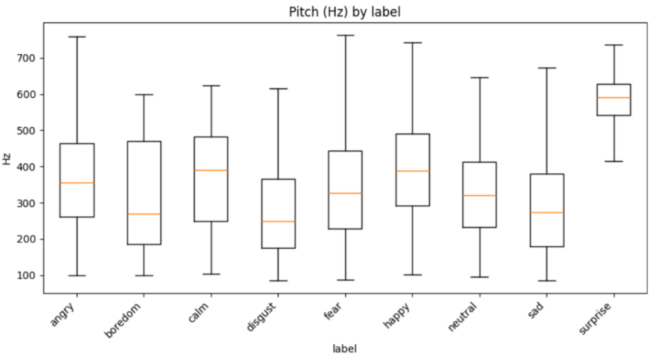
Data Cleaning: Exploratory Data Analysis (EDA)
3. Pitch: higher in happy/surprise, lower in sad/neutral
Emotional Speech Detector

Slide 17
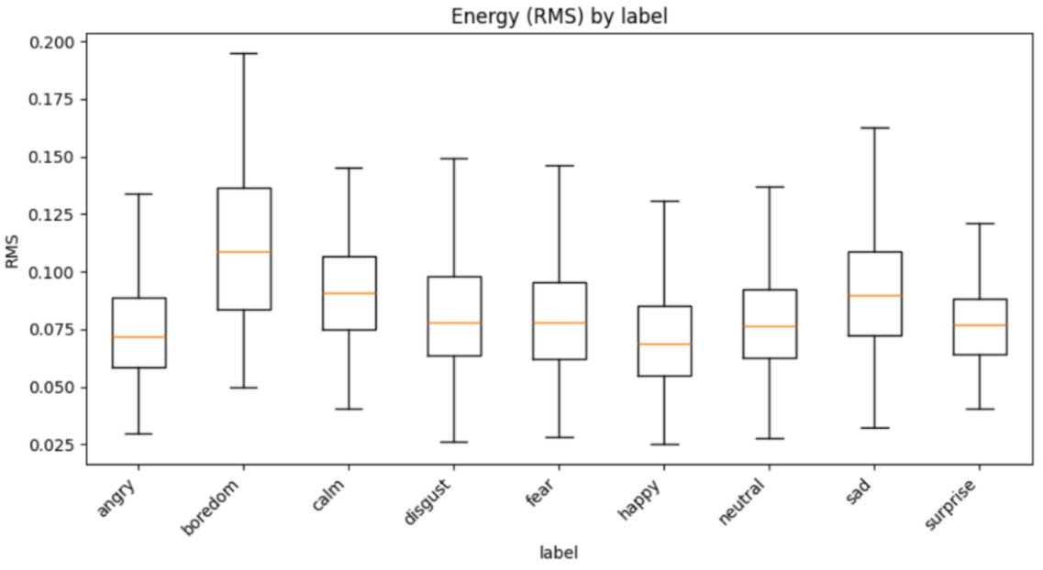
Data Cleaning: Exploratory Data Analysis (EDA)
4. Energy: higher in angry/happy, lower in sad/calm
Emotional Speech Detector

Slide 18
3. Implementation and Results
CNN
LSTM
CNN + LSTM
Random Forest Classifier
SVM
Emotional Speech Detector

Slide 19
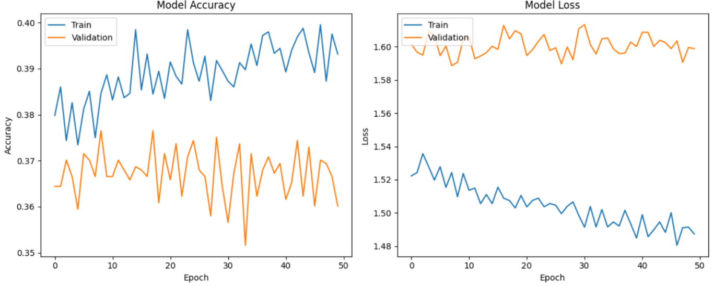
3.1 Implementation and Results: Convolutional Neural Network (CNN)
3.1.1 Training and Validation Performance
Emotional Speech Detector

Slide 20
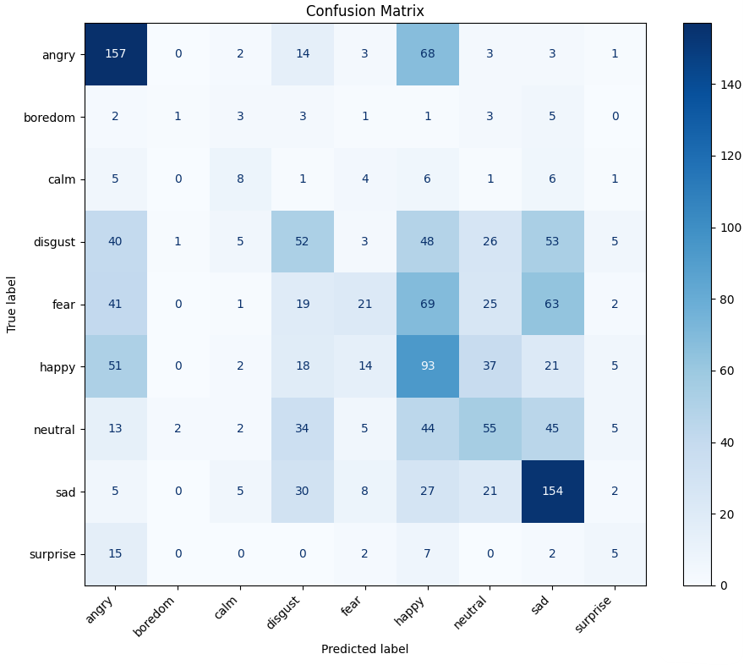
3.1 Implementation and Results: Convolutional Neural Network (CNN)
3.1.2 Confusion Matrix
Emotional Speech Detector

Slide 21
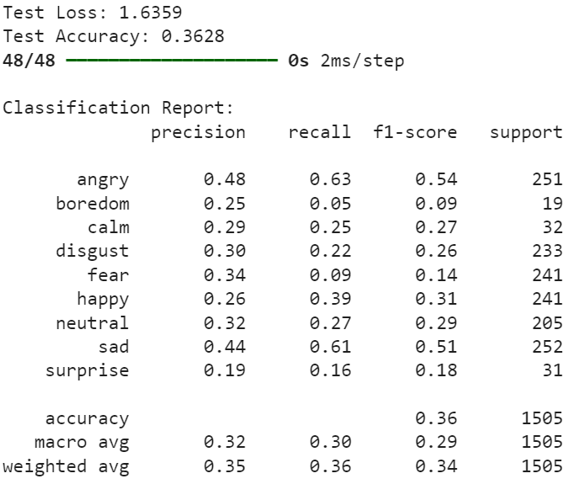
3.1 Implementation and Results: Convolutional Neural Network (CNN)
3.1.3 Summary
Angry / Sad: Very strong, high accuracy
Happy: Moderate, often confused with Angry & Neutral
Neutral: Weak, misclassified as Sad/Happy
Fear / Disgust: Low
Surprise / Boredom: Very weak
Emotional Speech Detector

Slide 22
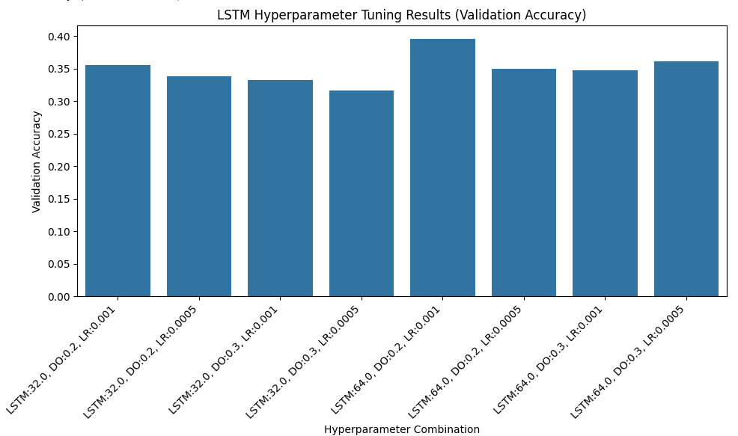
3.2 Implementation and Results: Long Short-Term Memory (LSTM)
3.2.1 Hyperparameter Tuning
Emotional Speech Detector

Slide 23
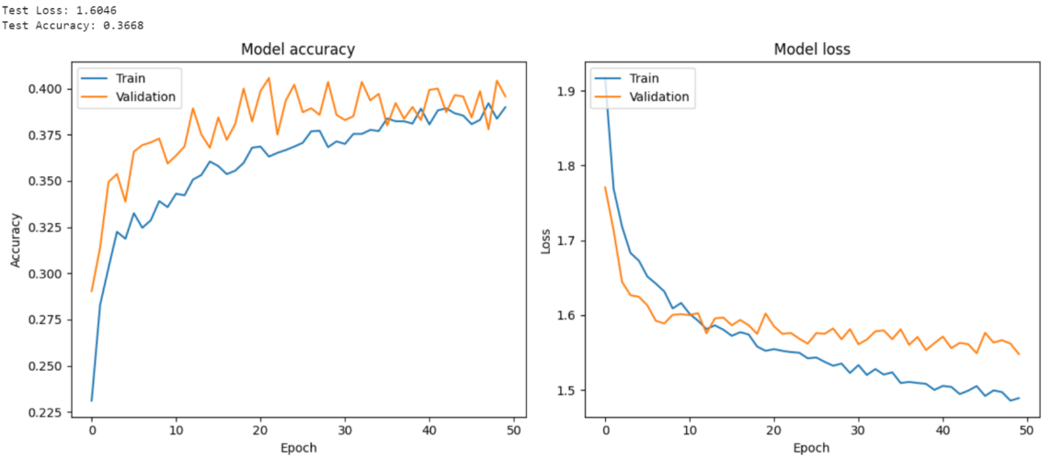
3.2 Implementation and Results: Long Short-Term Memory (LSTM)
3.2.2 Training and Validation Performance
Emotional Speech Detector

Slide 24
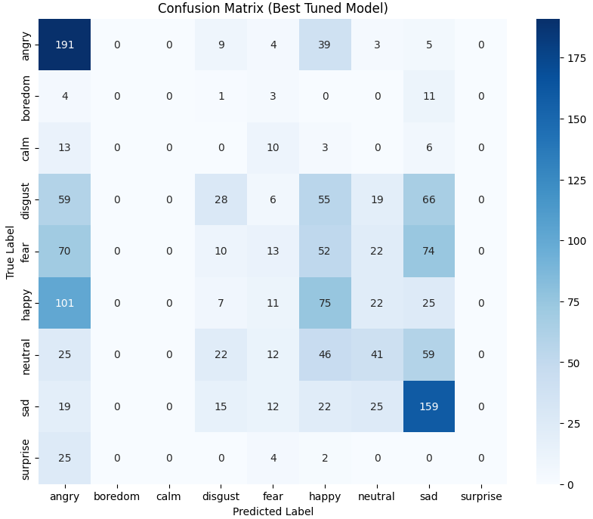
3.2 Implementation and Results: Long Short-Term Memory (LSTM)
3.2.3 Confusion Matrix
Fear and Surprise were detected more accurately than in CNN, thanks to sequential modeling
Emotional Speech Detector

Slide 25
3.2 Implementation and Results: Long Short-Term Memory (LSTM)
3.2.4 Summary of Results
Angry / Sad: Excellent recognition (191, 159 correct)
Happy: Moderate, overlaps with Angry & Neutral
Neutral: Weak, scattered across multiple classes
Fear / Disgust: Low, frequent misclassifications
Calm / Boredom / Surprise: Very poor, failed on Surprise (0 correct)
Insight: Captures temporal patterns → boosts strong emotions, but imbalance hurts low-frequency classes
Emotional Speech Detector

Slide 26
3.3 Implementation and Results: CNN + LSTM
3.3.1 Architecture and Training Setup
Trained on MFCC features with speaker-independent splits
Loss/Optimizer: Categorical cross-entropy, Adam (lr = 1e-3)
Input preprocessing: Standardized with training set statistics
Overfitting control: Early stopping + validation monitoring
Evaluation: Accuracy + imbalance-aware metrics
Emotional Speech Detector

Slide 27
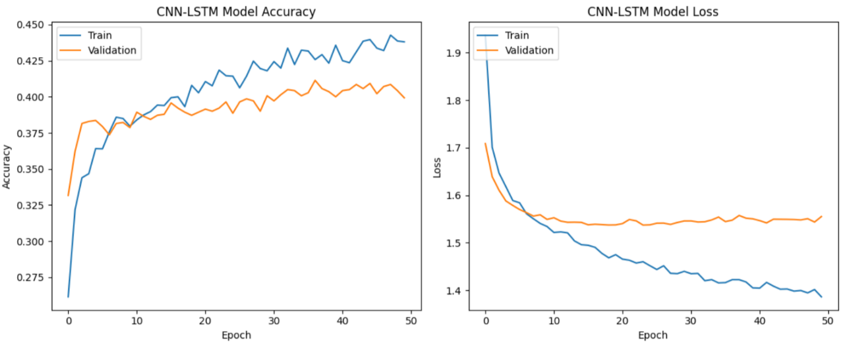
3.3 Implementation and Results: CNN + LSTM
3.3.2 Training and Validation Performance
Emotional Speech Detector

Slide 28
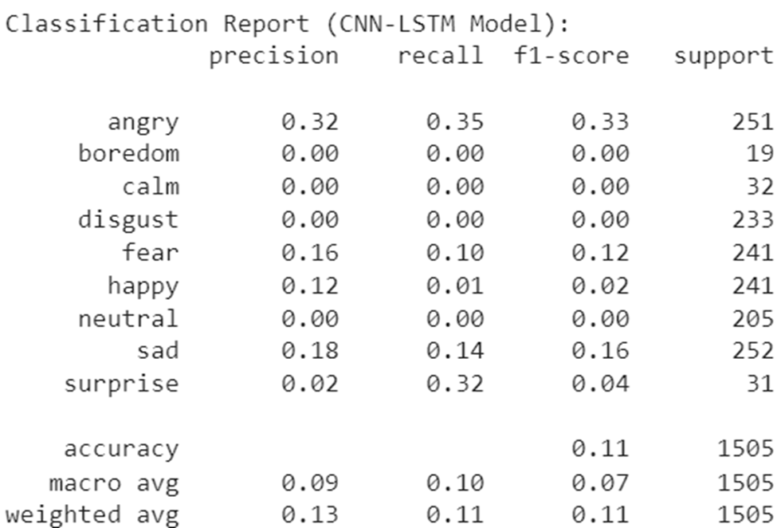
3.3 Implementation and Results: CNN + LSTM
3.3.3 Test-Set Performance
Overall test accuracy: ~11%, macro F1: ≈ 0.07 (very low)
Recall: Moderate for Angry & Surprise
Near-zero for Boredom, Calm, Disgust, Neutral
Performance gap indicates class-prior collapse and/or label/feature mismatch
Emotional Speech Detector

Slide 29
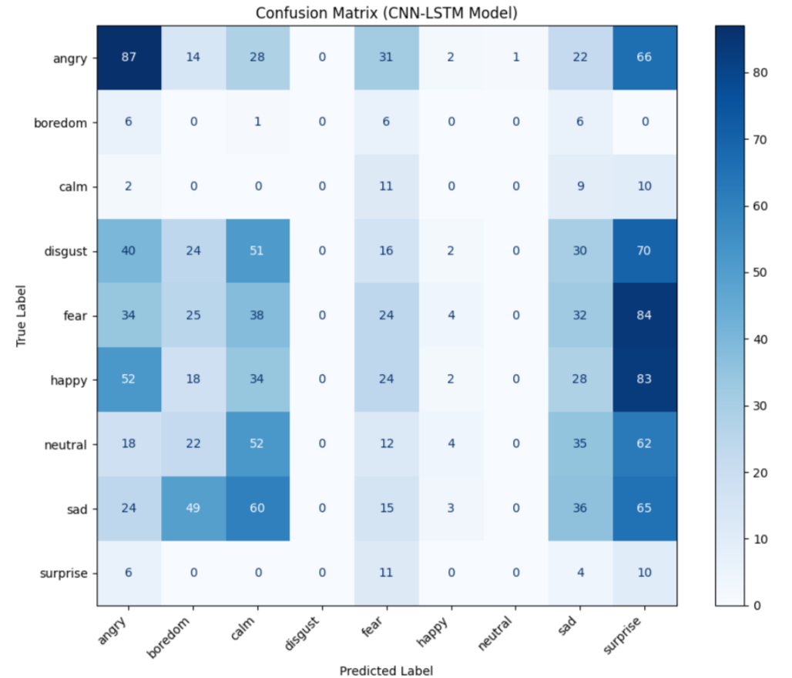
3.3 Implementation and Results: CNN + LSTM
3.3.4 Confusion Matrix
Angry/Happy/Fear → often misclassified as Surprise
Neutral & Sad → overlap due to low-energy patterns
Boredom/Calm/Disgust → rarely predicted (minority collapse)
Causes: Class imbalance, limited temporal context
Emotional Speech Detector

Slide 30
3.3 Implementation and Results: CNN + LSTM
3.3.5 Summary of Results
Test performance very low: Accuracy ≈ 0.11, Macro-F1 ≈ 0.07
Confusions concentrated in high-arousal classes
Issues: single-timestep input, class imbalance
Emotional Speech Detector

Slide 31
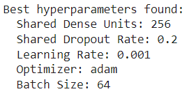
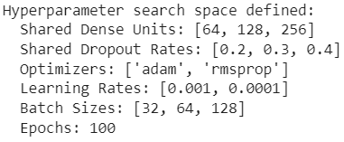
3.4 Implementation and Results: Random Forest Classifier
3.4.1 Hyperparameter Tuning
Emotional Speech Detector

Slide 32
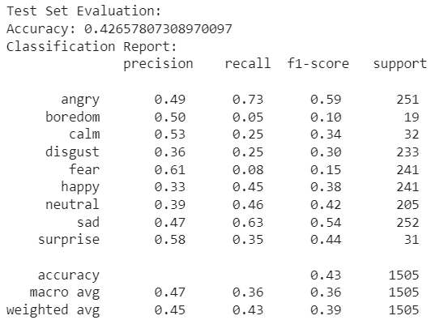
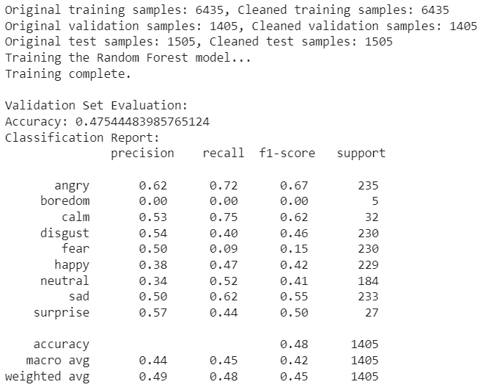
3.4 Implementation and Results: Random Forest Classifier
3.4.2 Training and Testing
Emotional Speech Detector

Slide 33
3.4 Implementation and Results: Random Forest Classifier
3.4.3 Summary of Results
SVM performed best overall, strong on angry, calm, sad, surprise
Random Forest & deep learning had lower accuracy (47.5% & 42.6%)
Deep learning struggled with class imbalance but can improve with more data
SVM: highest macro-F1 & UAR, fast and consistent
Emotional Speech Detector

Slide 34
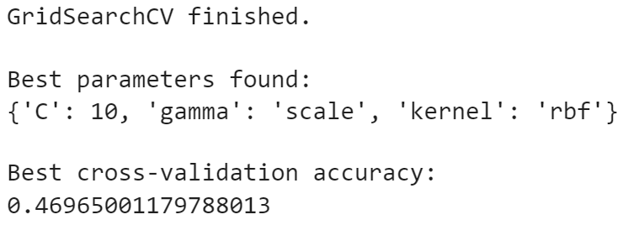
3.5 Implementation and Results: Support Vector Machine (SVM)
3.5.1 Hyperparameter Tuning
RBF kernel with moderate regularization improved sadness & disgust; some overlap remains for angry/happy/fear
Emotional Speech Detector

Slide 35
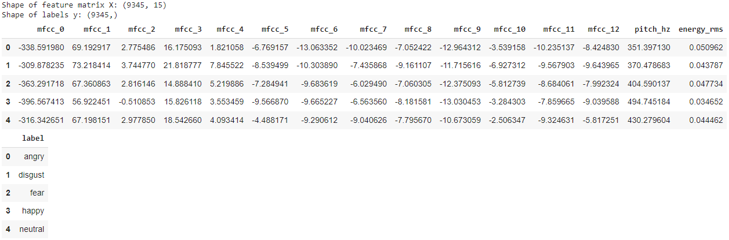
3.5 Implementation and Results: Support Vector Machine (SVM)
3.5.2 Training and Validation Performance
Emotional Speech Detector

Slide 36
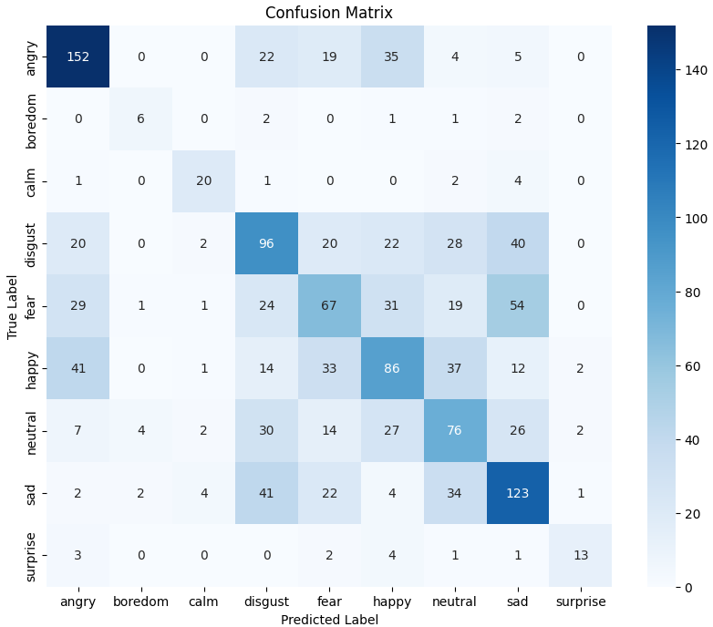
3.5 Implementation and Results: Support Vector Machine (SVM)
3.5.3 Confusion Matrix
Emotional Speech Detector

Slide 37
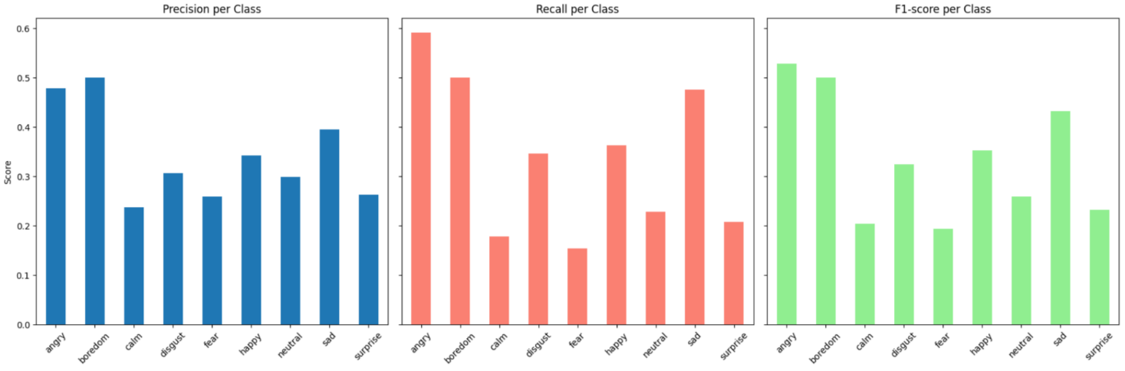
3.5 Implementation and Results: Support Vector Machine (SVM)
3.5.4 Summary of Results
Emotional Speech Detector

Slide 38
4 Model Demonstration and Future Vision
Emotional Speech Detector

Slide 39
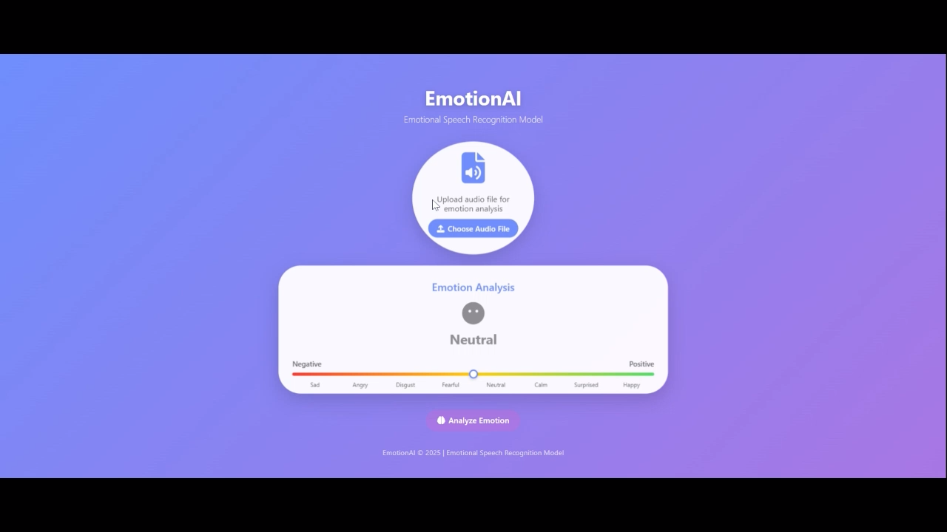

Slide 40
References
Burnwal, S. (2018). Speech emotion recognition. Kaggle. https://www.kaggle.com/code/shivamburnwal/speech-emotion-recognition
Dincer, B. (2021). Emotional speech recognition / AUDIO PROCESS / ALL. Kaggle. https://www.kaggle.com/code/brsdincer/emotional-speech-recognition-audio-process-all
University of South California. (2004) IEMOCAP Database. https://sail.usc.edu/iemocap/
PLOS One. (2018). RAVDESS Database, official paper. https://journals.plos.org/plosone/article?id=10.1371/journal.pone.0196391
NIH. (2015). CREMA-D database paper. https://pmc.ncbi.nlm.nih.gov/articles/PMC4313618/
Kaggle. CREMA-D database. https://www.kaggle.com/datasets/ejlok1/cremad
GitHub. (2018). CREMA-D Demographs dataset. https://github.com/CheyneyComputerScience/CREMA-D/blob/master/VideoDemographics.csv
Librosa. (2015). librosa docs. https://librosa.org
OpenSmile. (2022). Opensmile doc. https://audeering.github.io/opensmile/
OpenAI. (2025). ChatGPT (GPT-5) [Large language model]. https://chat.openai.com/
Google. (2025). Gemini [Large language model]. https://gemini.google.com/
Emotional Speech Detector

Slide 41
CAPSTONE PRESENTATION
ARTIFICIAL INTELLIGENCE BOOTCAMP 2025
Thank You
Reem Basho
Yasmine Hariri
Rand Al Yaman
Mahdi Dagher
Saida, 3 October 2025

